Slide 1
Learnt dynamics generalizes across tasks, population and datasets
U. Mahmood, M. M. Rahman, A. Fedorov, Z. Fu, V. D. Calhoun, S. M. Plis
Tri-institutional Center for Translational Research in Neuroimaging and Data Science: Georgia State University, Georgia Institute of Technology, Emory University
Atlanta, GA, USA

Slide 2
Main Problem
Differentiating multivariate dynamic signals. Why?
Classification.
Prediction.
Finding root cause of classification/prediction.
What’s challenging in it?
Use A LOT of data, get big GPUs.
Acquire good features from the input data -> Use tradition ML approaches.
What if you have only 15 labeled subjects?

Slide 3
Goal
Solve the main problem ☺
Learn dynamics with 15 labeled subjects
Classify
Predict
Find root cause

Slide 4
Motivation
If getting publication is not enough motivation for you.
Applies to many areas. Such as; NLP, Imaging.
Examples:
Time Series (weather prediction etc.)
Keyword Detection. Hey Google/Siri/Cortana/Alexa
Neuroimaging (fMRI signals, ICA components)
Classify diseases like SZ, Autism, AD etc.

Slide 5
Our Logic/Solution
Large but unrelated and unlabeled data.
Self-supervised learning (Pre-Training)
Learn dynamics
Create embedding
Apply the learn model/encoder on downstream task (Transfer & Supervised learning)
Further train encoder on downstream task. (UFPT)
Freeze encoder for downstream task. (FPT)

Slide 6
Self Supervised learning (Pre-Training)
ST-DIM (Spatio-Temporal Deep InfoMax)
Autoencoder (May be variational if you want to get too fancy)

Slide 7
ST-DIM
Break the time series or sequence in windows.
Maximize mutual information between consecutive windows.
Classify between positive and negative pairs.
Consecutive windows are positive, and every other pair is negative.

Slide 8
ICA
1
Components
………
53
1
140
Time Courses
Positive Pair
Negative Pair

Slide 9
ST-DIM

Slide 10
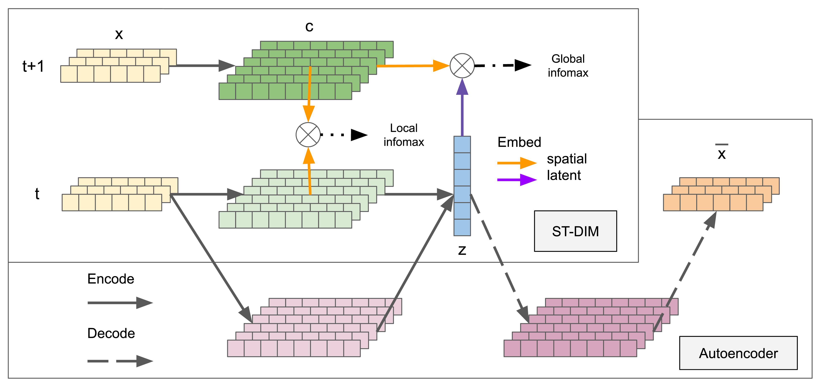
Architecture

Slide 11
Reduction:
Reconstruction:
Loss:
Autoencoder

Slide 12
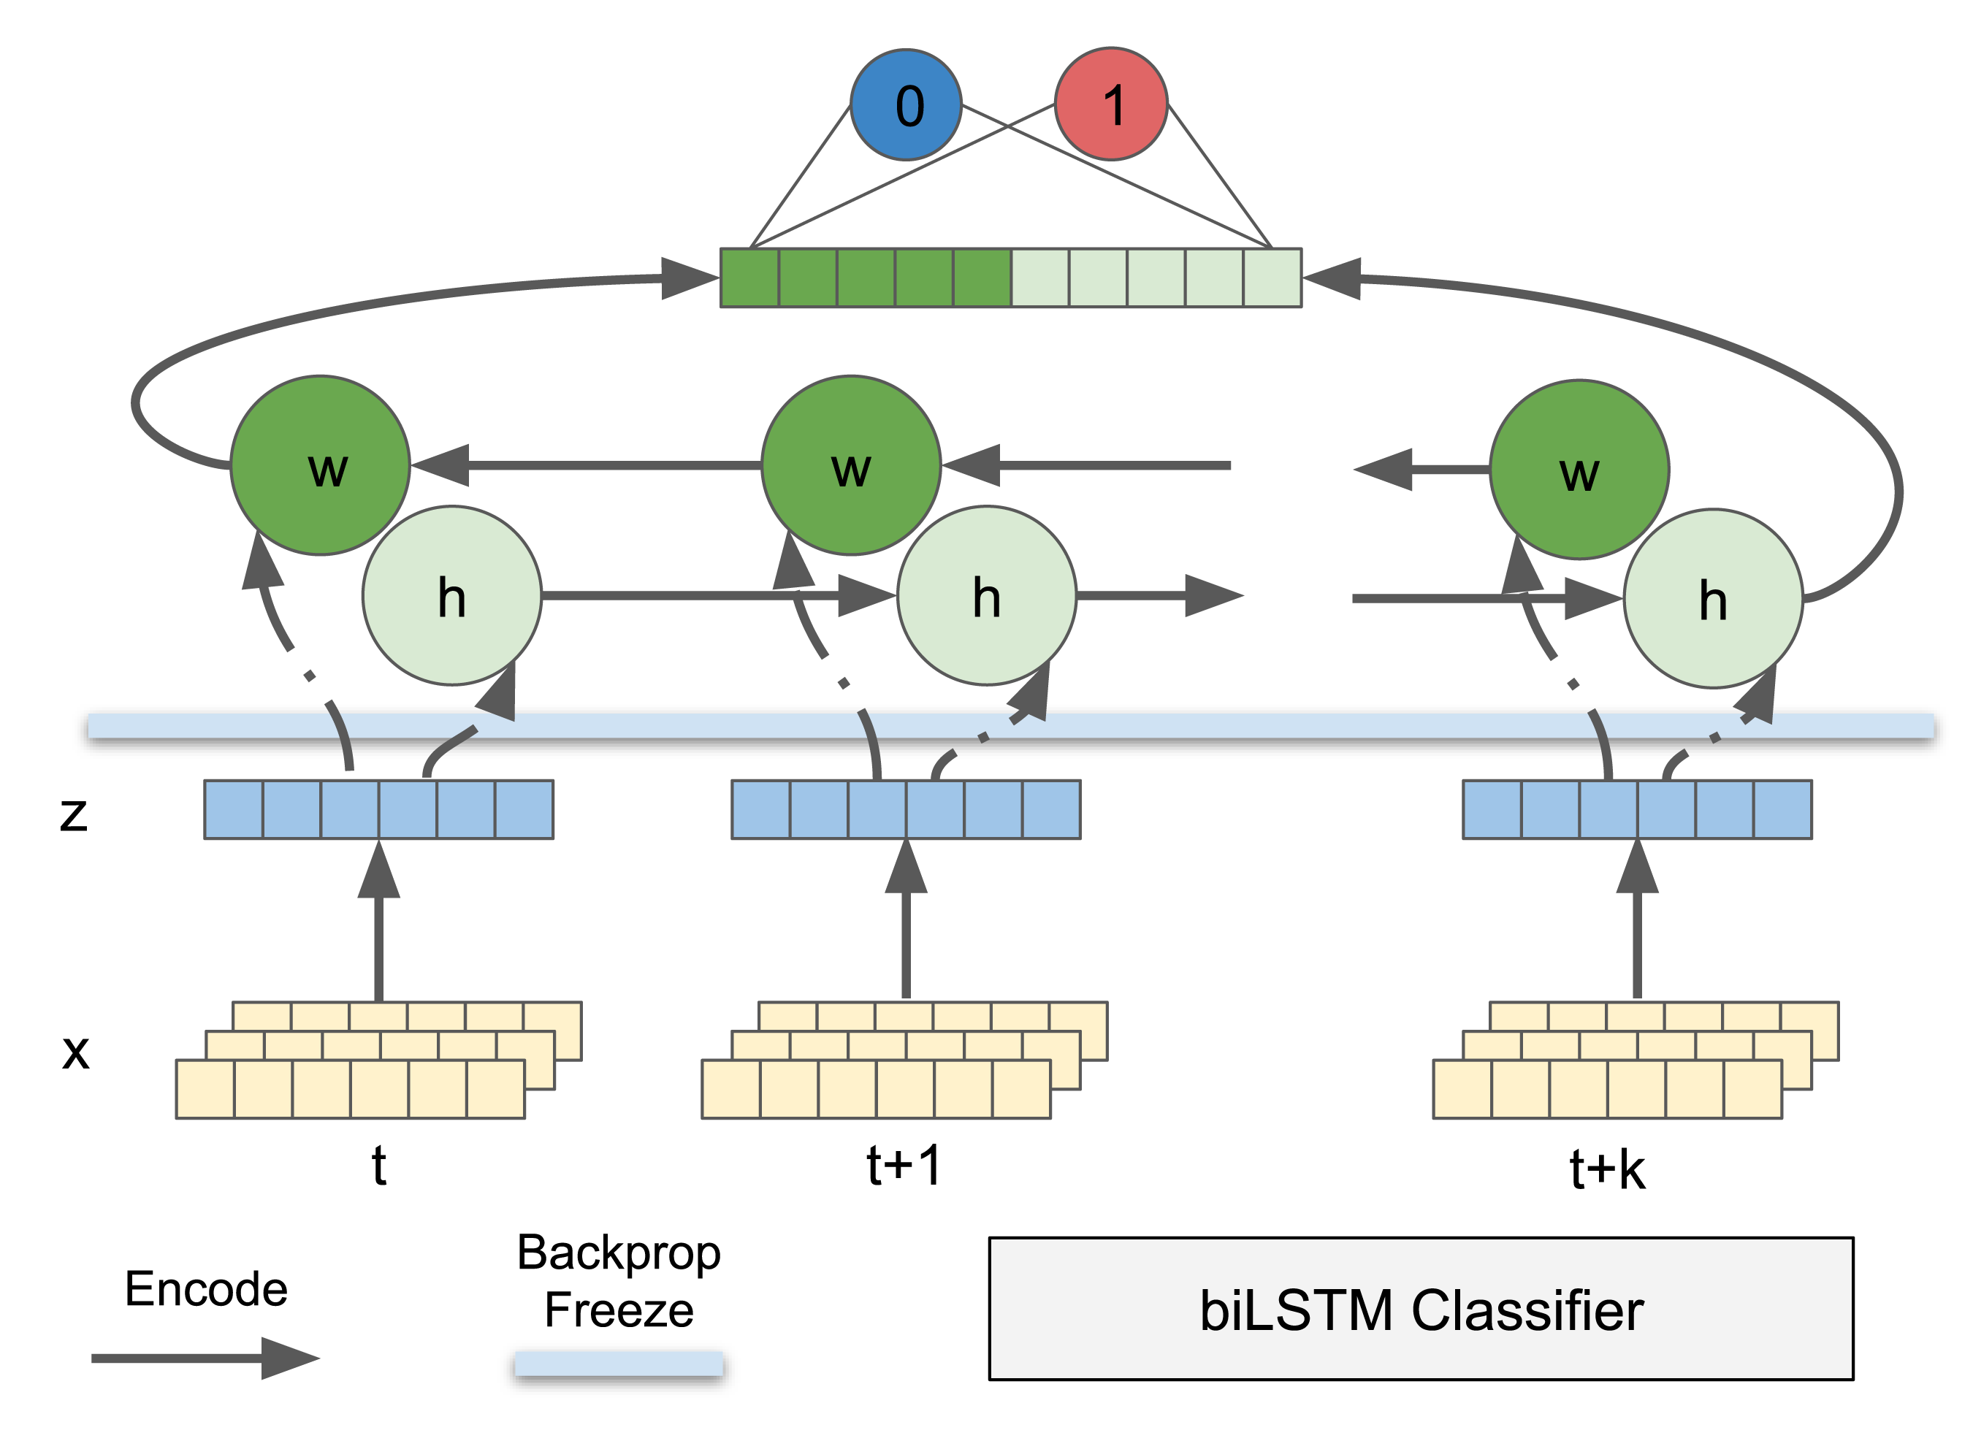
Training Architecture

Slide 13
Training Models

Slide 14
Generate multiple 10-node graphs with 10×10 stable transition matrices
Generate 50 multivariate VAR time series.
Using ST-DIM and autoencoder, pre-train the same encoder.
Simulation
Pre-training

Slide 15
What do we do?
--- VAR vs. SVAR classification
Use the same steps to create training VAR and SVAR time series
SVAR is undersampled VAR with ratio (1:2)
Simulation
Downstream task

Slide 16
Simulation
Results

Slide 17
Real Data
Keyword Detection
Schizophrenia
FBIRN
COBRE
Autism
ABIDE1
Alzheimer’s Disease
OASIS3
FPT(Frozen Pre-Trained), UFPT(UnFrozen Pre-Trained), NPT(Not Pre-Trained)

Slide 18
Datasets for Brain tests

Slide 19
Keyword Detection
Pre-Training on LibriSpeech + Background noise
Training and classification on Speech Commands + Background noise.

Slide 20
Schizophrenia
HCP and FBIRN
HCP and COBRE

Slide 21
Autism
HCP for Pre-Training. ABIDE1 for downstream task.

Slide 22
Alzheimer's Disease
HCP for Pre-Training OASIS3 for downstream task.

Slide 23
On-Going work
Model Introspection
- Saliency
Use attention mechanism

Slide 24
Future Work
Move to fMRI brain slices
Whole brain instead of ICA components.
Switch to other mental disorders such as MCI and bipolar.

